Slide 1
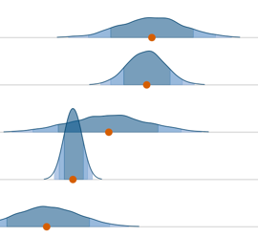
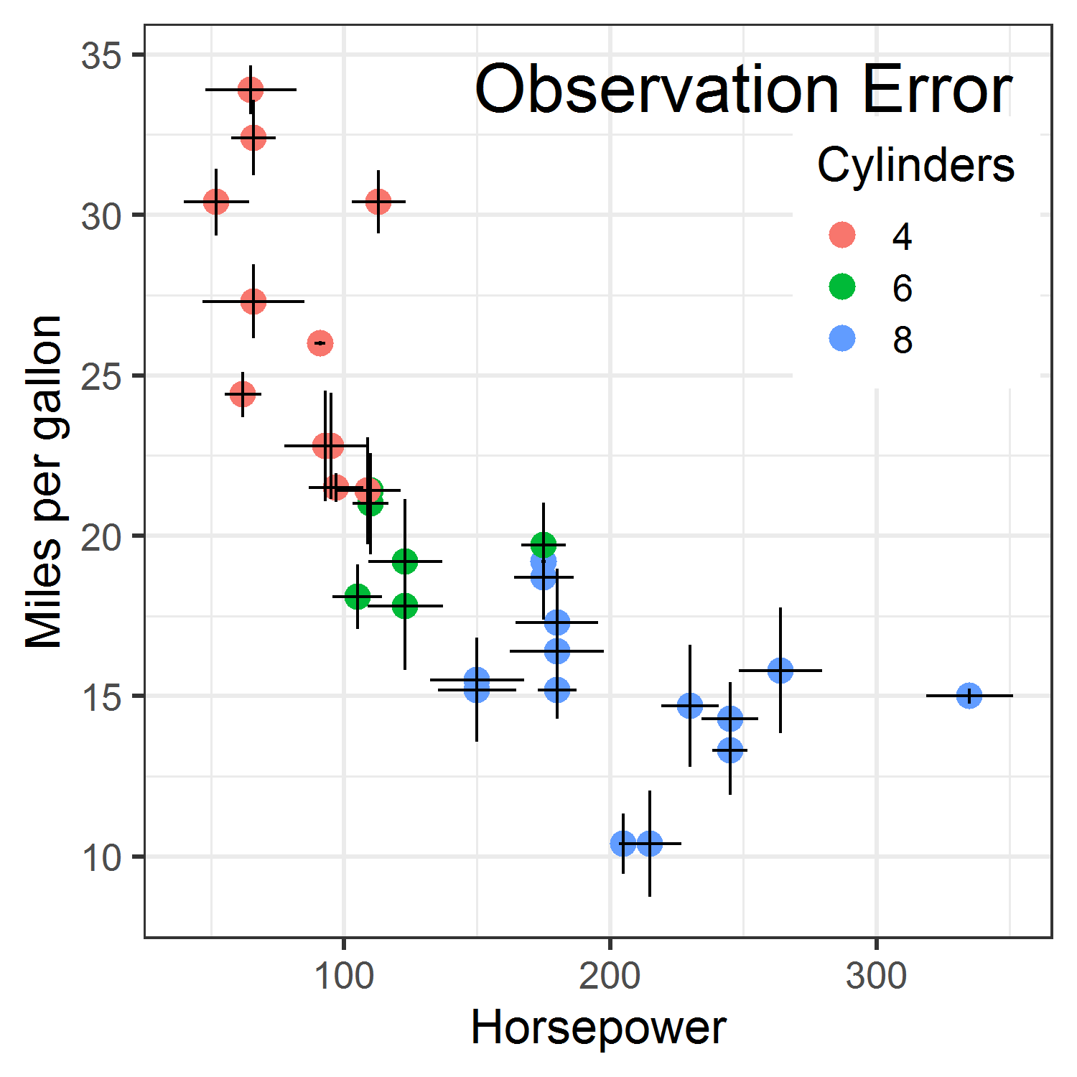
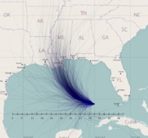
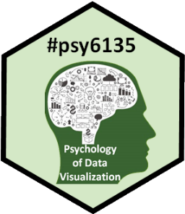
Visualizing Uncertainty
Michael Friendly
Psych 6135
https://friendly.github.io/6135/

Slide 2
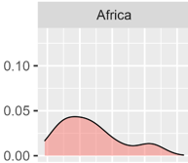
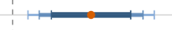
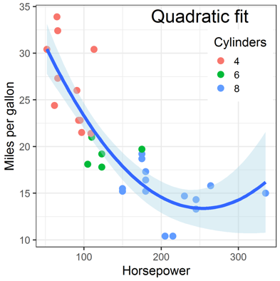
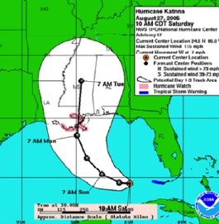
Today’s topics
Uncertainty in statistics & visualization
Visualizing distributions
“Error bars”
Bayesian uncertainty
Uncertainty in fitted curves
Hypothetical outcome plots
Cartographic uncertainty

Slide 3
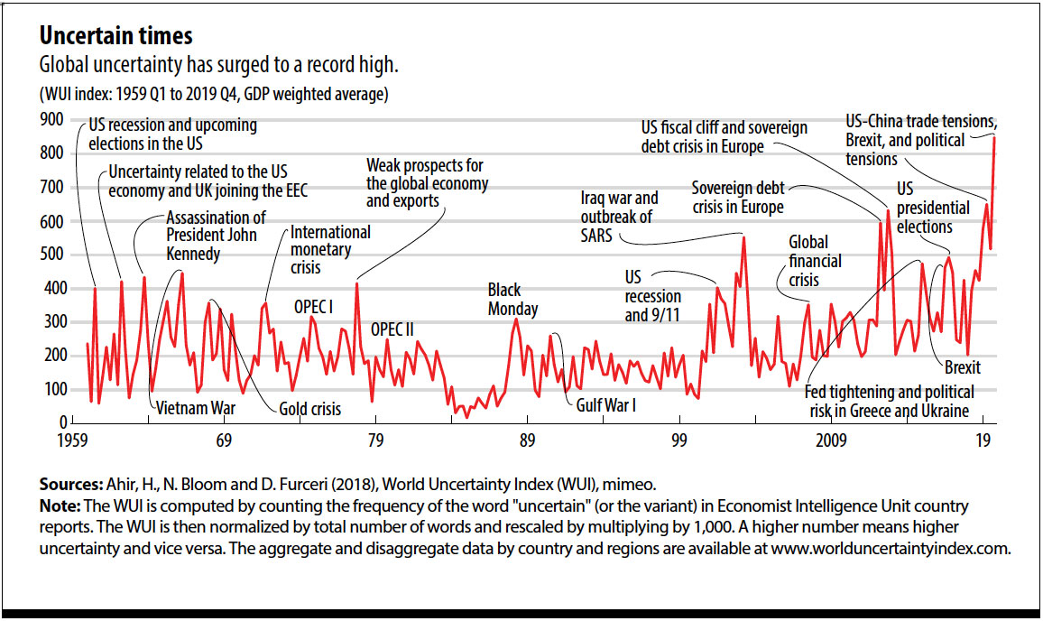
What is uncertainty?
World Uncertainty Index https://worlduncertaintyindex.com

Slide 4
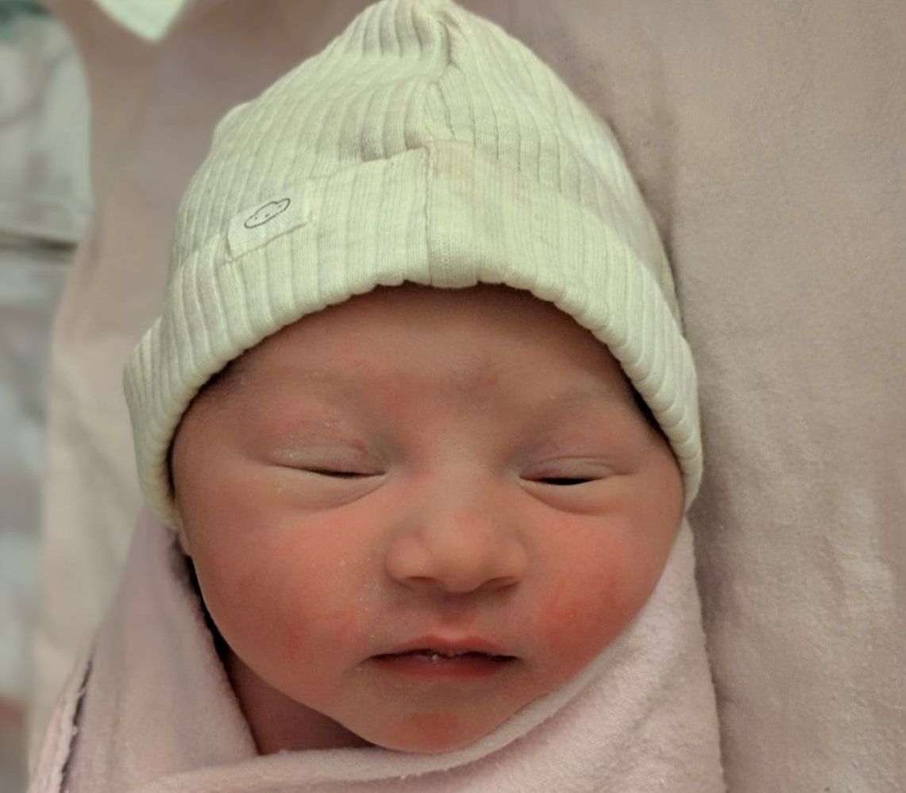
What is uncertainty?
Hello, Sakina Asma Zia!
Where am I?
What’s for breakfast?

Slide 5
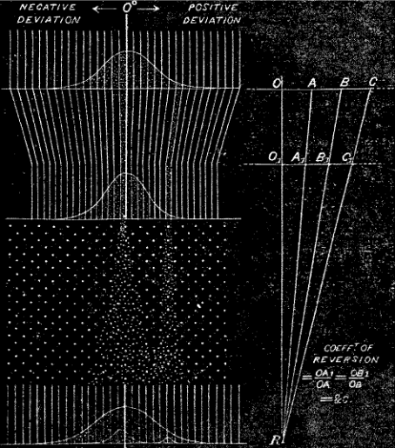
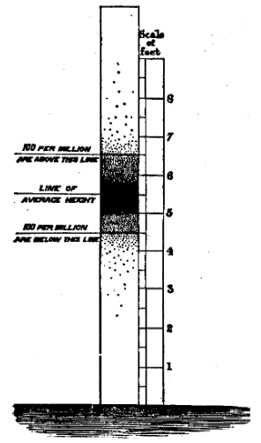
Galton: Variation & Uncertainty
Distribution of human height (Hereditary Genius, 1867)
Quincunx: How many small effects → Normal

Slide 6
Sources of uncertainty
Where does the uncertainty in statistics come from? There are four main sources:
Data: data can contain random error or have missing entries.
Assumptions: model assumptions provide plausible values from distributions.
Models: there is choice over the techniques and models we use.
Different analysts may choose different methods, yielding different estimates.
Replications: Estimates of effects can vary from study to study. How to synthesize these?
See: Uncertainty Toolkit, Ch 3 for other terms to understand uncertainty

Slide 7
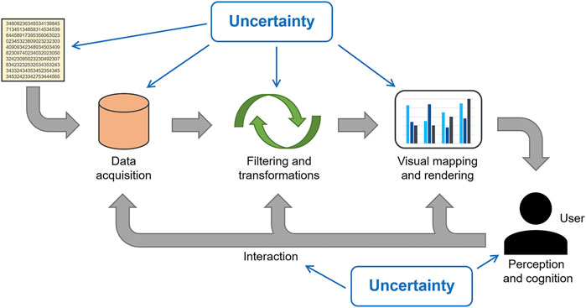
Where does uncertainty come from?
Analyst centered
Audience centered
From: D. Weiskopf, https://www.frontiersin.org/articles/10.3389/fbinf.2022.793819/full

Slide 8
Problems: data, models, graphics
Uncertainty is fundamental to data analysis & models
data: IQR, std dev., std error, … (variation)
assumptions: we assume some distribution for errors, e.g., ε ~ N(0, σ²), independent with constant variance
models:
classical: confidence intervals, p-values;
Bayesian: credible intervals, posterior distributions
In data graphics,
Easy to show “fit” – means, regression estimates, …
Harder to show the uncertainty in these numbers

Slide 9
P-values, significance & uncertainty
ASA President’s Task Force on Statistical Significance (2021)
“Much of the controversy surrounding statistical significance can be dispelled by better understanding of uncertainty, variability, multiplicity & replicability”
“Different measures of uncertainty can complement each other; no single measure serves all purposes”
“Controlling and accounting for uncertainty begins with the design of the study”
“The theoretical basis of statistical science offers general strategies for dealing with uncertainty”
Frequentist approach: p-values, confidence intervals & prediction intervals
Bayesian approach: Bayes factors, posterior probability distributions, credible intervals
https://magazine.amstat.org/blog/2021/08/01/task-force-statement-p-value/

Slide 10
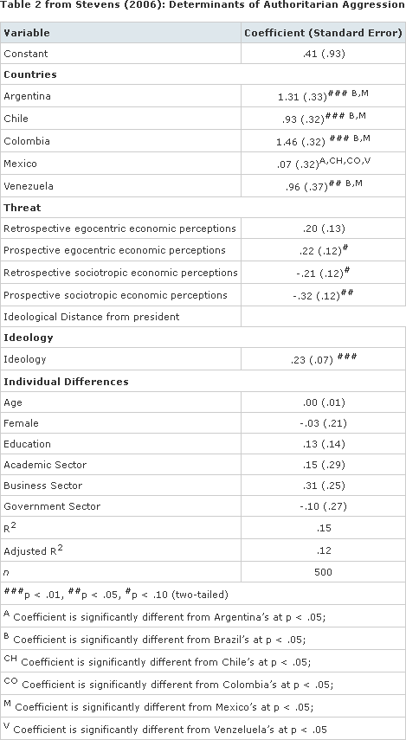
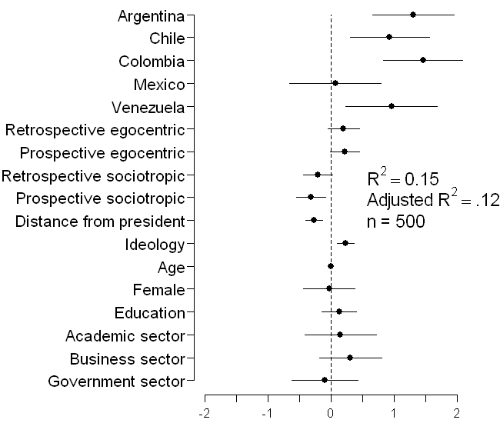
Model fits as uncertainties
Coefficients** & std errors express uncertainty
Can we do better?
Source: tables2graphs.com

Slide 11
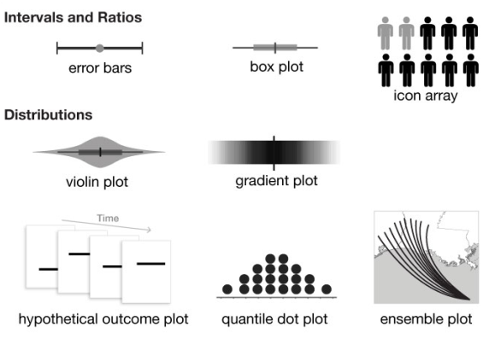
Graphical annotations for uncertainty
From: Padilla, Kay & Hullman (2021), Uncertainty Visualization, DOI: 10.1002/9781118445112.stat08296

Slide 12
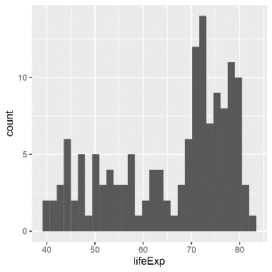
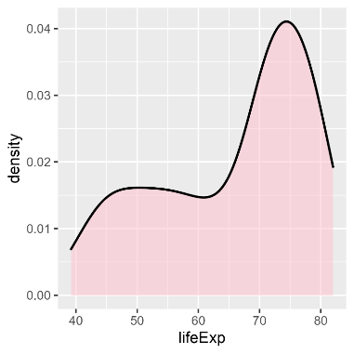
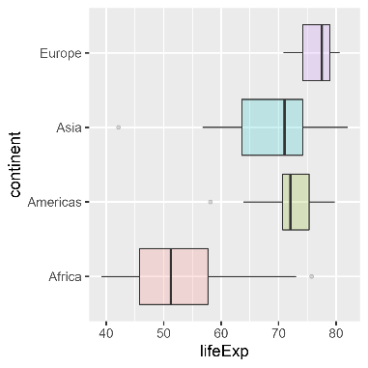
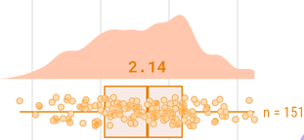
Visualizing distributions
The basics:
Icon arrays
Histograms
Density plots
Boxplots
Doing better:
violin plots
rainclouds
{ggdist}: data, distribution, interval

Slide 13
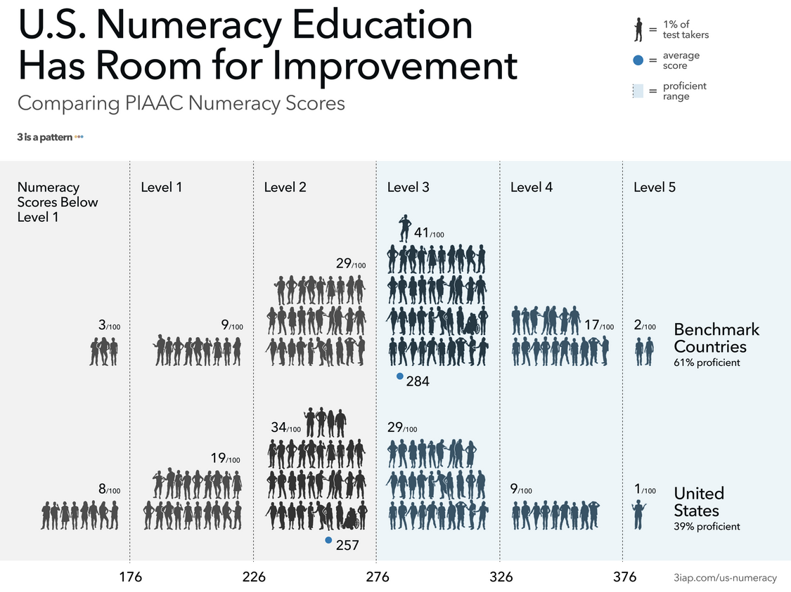
Putting the people back into charts about them:
Icon array
From: https://3iap.com/us-numeracy
Weepeople font: https://github.com/propublica/weepeople

Slide 14
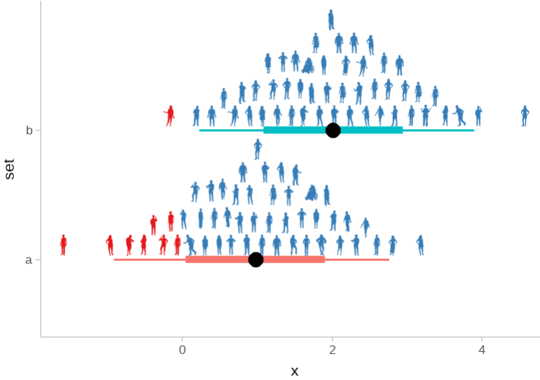
Using weepeople font in R graphics
See: https://github.com/mjskay/uncertainty-examples/blob/master/weepeople_dotplots.md
Download font from: https://github.com/propublica/weepeople/
Register font: systemfonts::register_font(name = "weepeople“)
df = data.frame(x = qnorm(ppoints(100), 1:2),
set = c("a", "b"), icon = factor(sample(52, 100, replace = TRUE)))
people = c(letters, toupper(letters))
df |> ggplot(aes(x = x, y = set, group = set, shape = icon, color = x > 0)) +
geom_dots(family = "weepeople", dotsize = 2.4, layout = "swarm") +
scale_shape_manual(values = people, guide = "none") +
scale_color_brewer(palette = "Set1", guide = "none")
Code: https://github.com/friendly/6135/R/weepeople.R

Slide 15
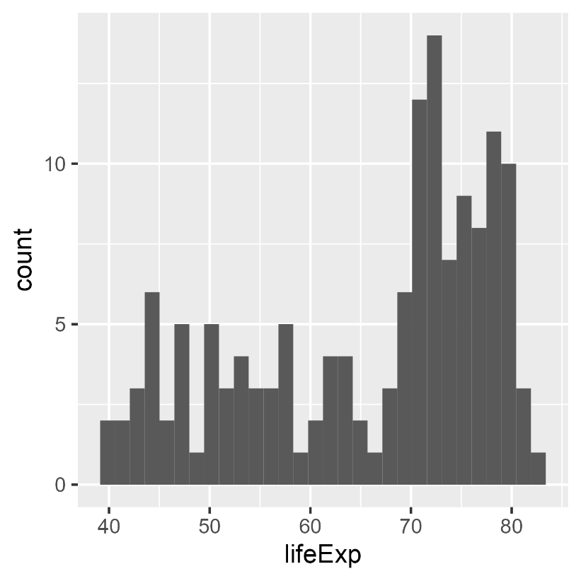
Histograms
Perhaps the simplest display
divide the data into bins: [40-42), [42-44), …
bar plot of the frequencies: length ~ frequency in bin
library(gapminder)
gapminder_2002 <- gapminder %>%
filter(year == 2002)
ggplot(gapminder_2002,
aes(x = lifeExp)) +
geom_histogram()
`stat_bin()` using `bins = 30`. Pick better value with `binwidth`.

Slide 16
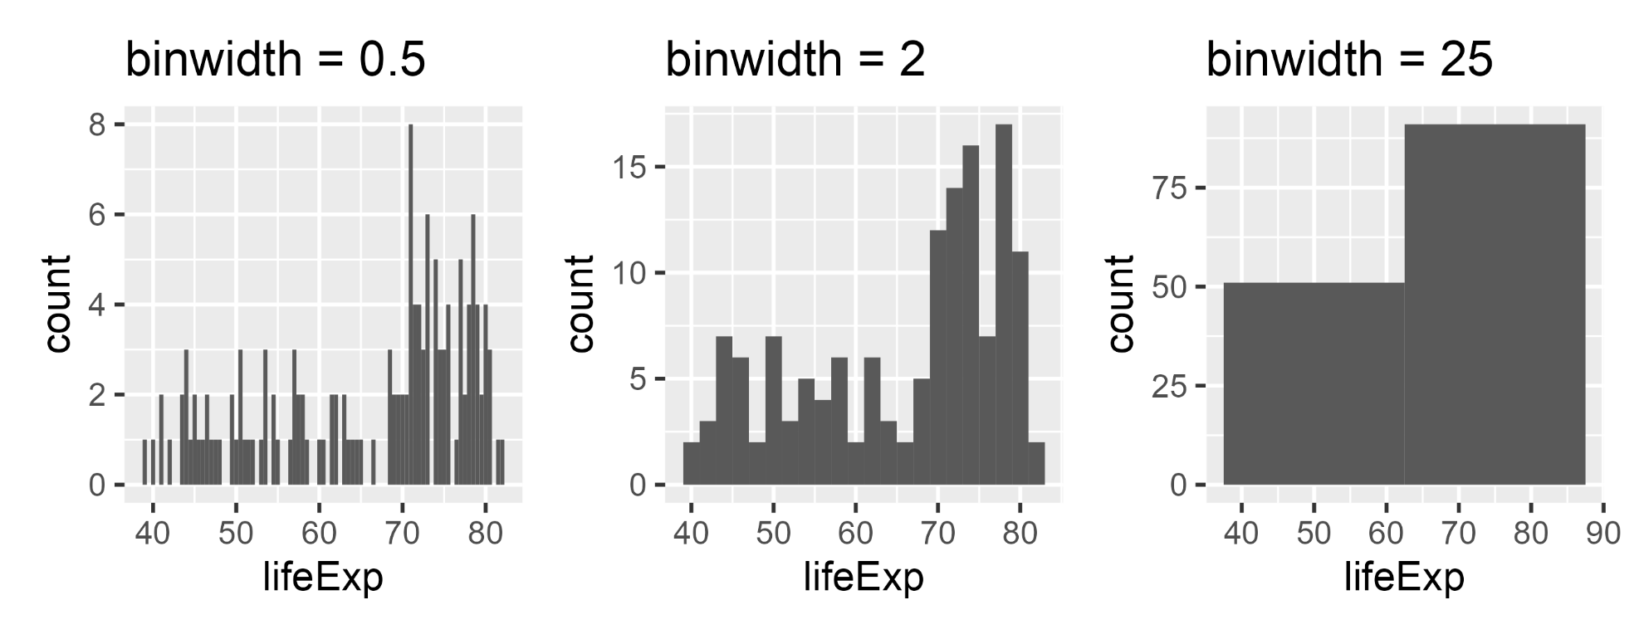
Histograms: bin width
Explicitly selecting the binwidth shows:
the “Goldilocks” principle: just about right
the default is often OK, but optimal “best” is harder to define
ggplot(gapminder_2002, aes(x = lifeExp)) + geom_histogram(binwidth = )
too small
about right
too large

Slide 17
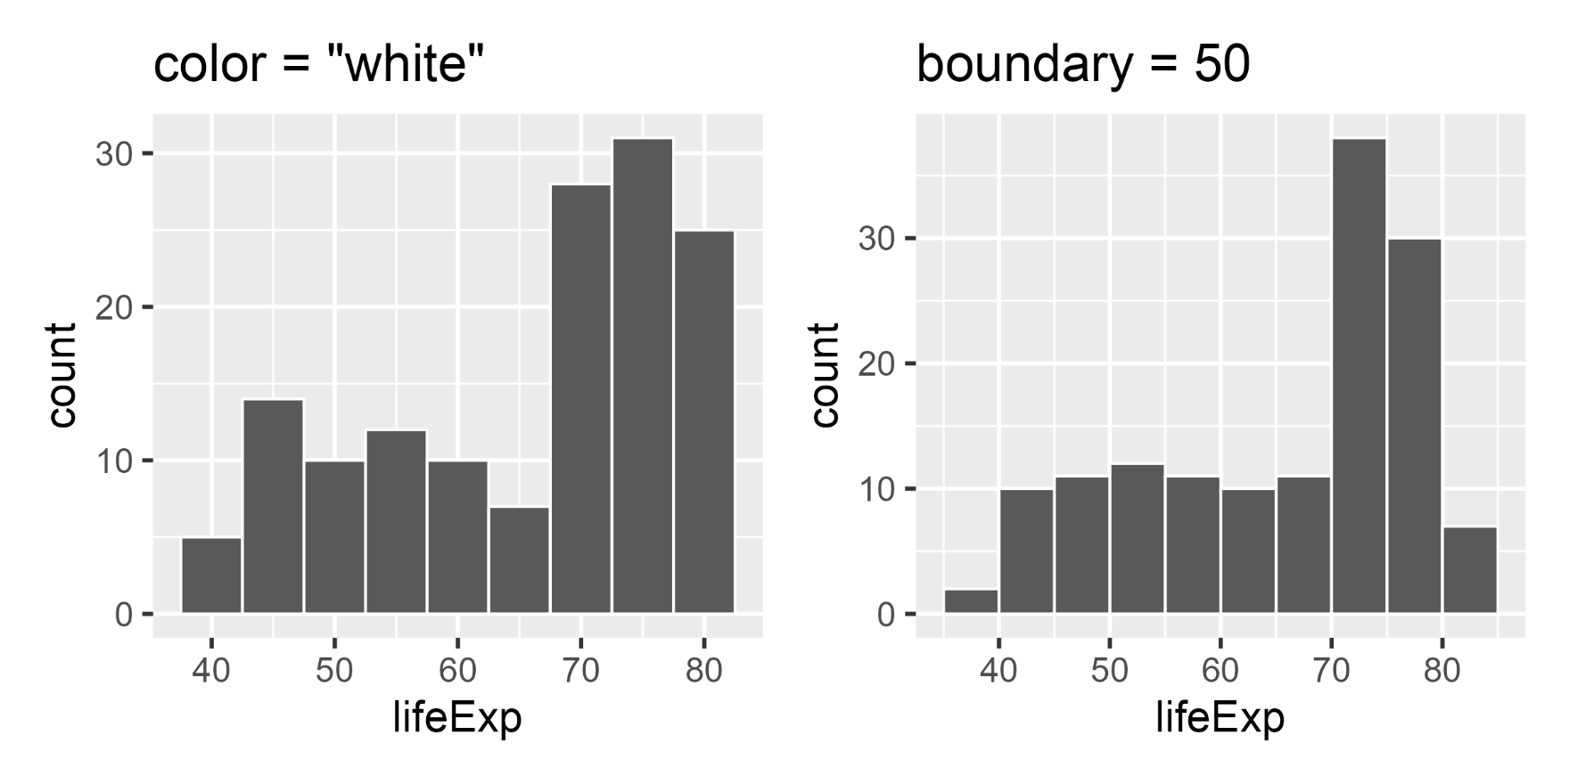
Histograms: other properties
Pay attention to graphic details
border color to make bars distinct
set bar boundaries: to edges? – it can make a difference
geom_histogram(…, color = “white”)
geom_histogram(…, boundary=50)

Slide 18


Density plots
Basic idea: Smooth the distribution to avoid artifacts of discrete bins and bin centers
Uses a “kernel”, e.g, gaussian, averaged over a moving window
geom_histogram()
geom_density()

Slide 19
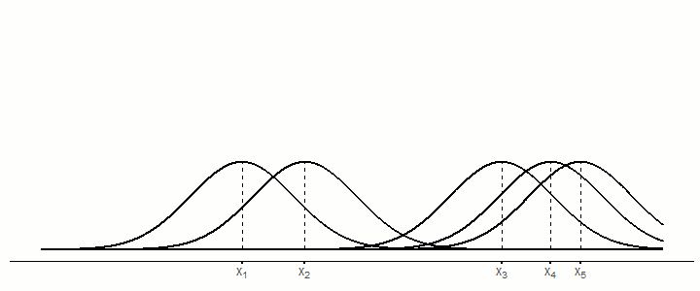
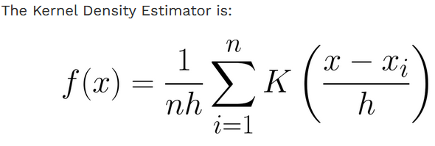
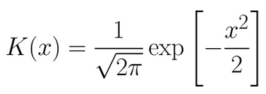
Kernel density estimation
Imagine a distribution of potential density centered at each X_{i}, w/ sd = h (bandwidth)
x ~ N(μ=X_{i}, σ=h)
Five observations, each with a distribution
A moving window sweeps across, averaging the density for all observations
Kernel function

Slide 20
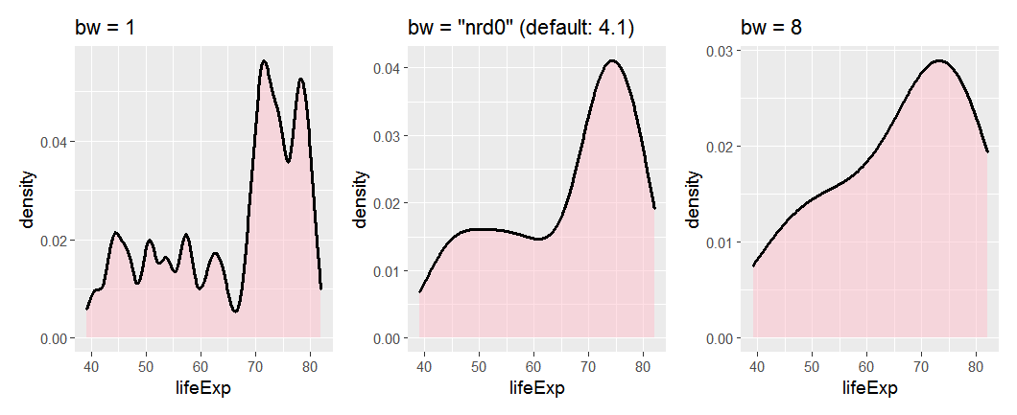
Density plots: bandwidth
The result depends on the width of the moving window – bandwidth
The default calculation is usually reasonable, but beware of weird data
geom_density(bw=1)
geom_density()
geom_density(bw=8)

Slide 21
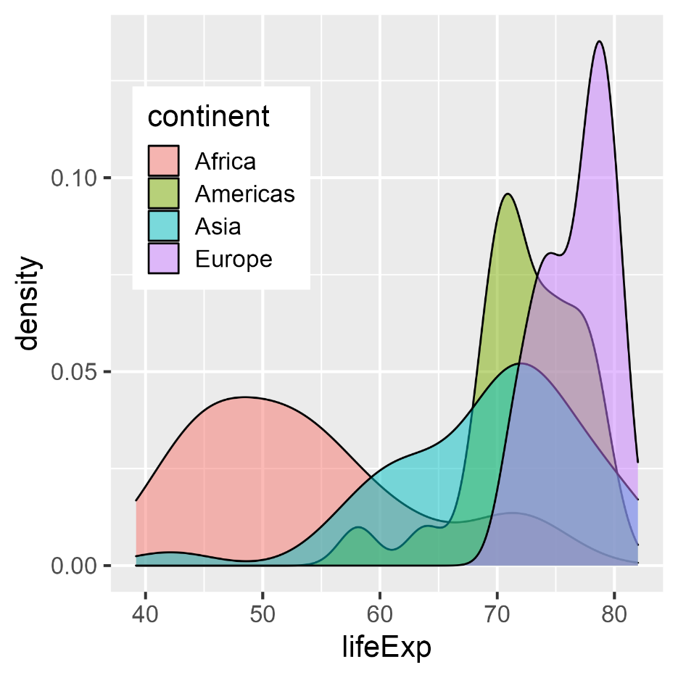
Comparing groups
For multiple groups, using the fill aesthetic → overlaid curves -- is a decent start
But even with transparency it may be hard to see the separate curves
gap_2002c <-
gapminder_2002 %>%
filter(continent != "Oceania")
ggplot(gap_2002c,
aes(x = lifeExp,
fill = continent)) +
geom_density(alpha = 0.5) +
theme(legend.position = c(.2, .7))
NB: ggplot picks a joint bandwidth, here: 2.52

Slide 22
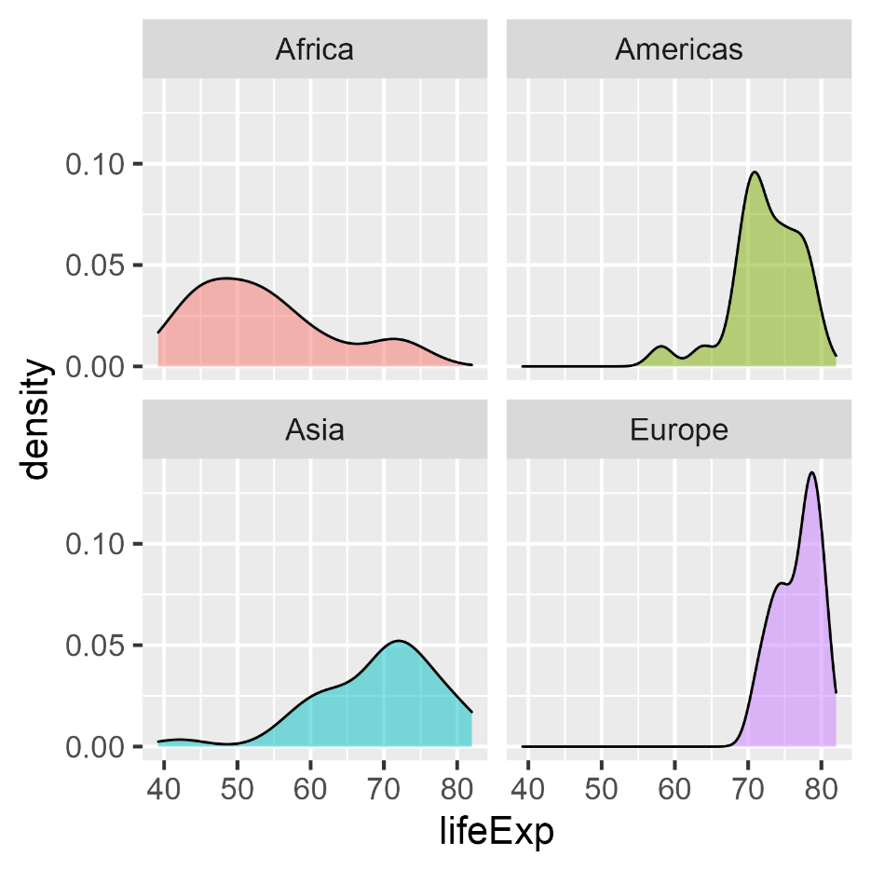
Comparing groups: Facets
Faceting solves the overlap problem, but the eye has to move from panel to panel to make comparisons.
ggplot(gap_2002c,
aes(x = lifeExp,
fill = continent)) +
geom_density(alpha = 0.5) +
facet_wrap(~ continent) +
theme(legend.position = "none")

Slide 23
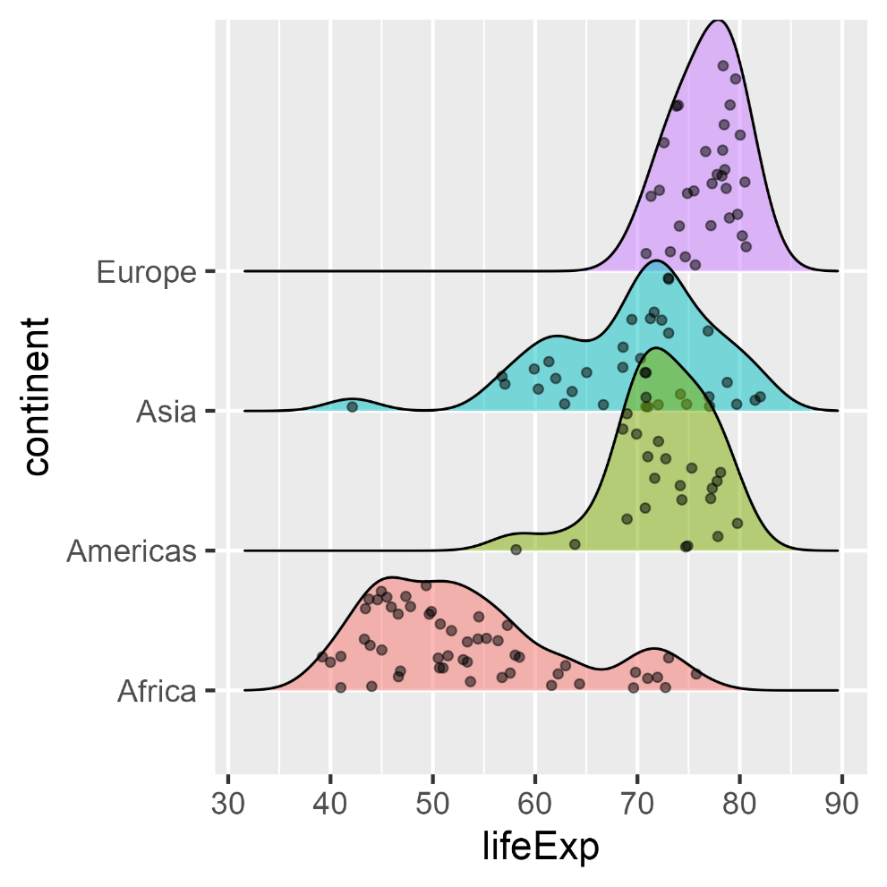
{ggridges}: Ridgeline plots
Ridgeline plots are partially overlapping density plots, suggesting a mountain range.
Useful for comparing distributions over time or circumstances
Adding jittered points helps to show where the data are
library(ggridges)
ggplot(gap_2002c,
aes(x=lifeExp,
y=continent,
fill=continent)) +
geom_density_ridges(
alpha = 0.5,
jittered_points=TRUE) +
theme(legend.position = "none")

Slide 24
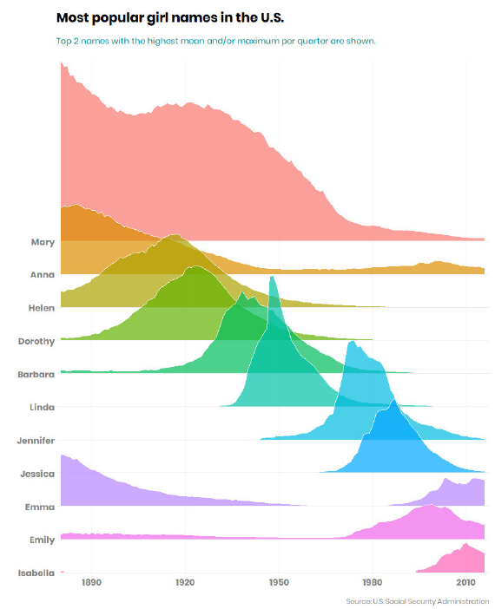
Baby names
Ridgeline plots are particularly effective with more than a few categories, and when the distributions differ in shape as well as central location
Which names stand out from the rest?
What is the role of color here?
Note the subtle use of white to outline each distribution

Slide 25
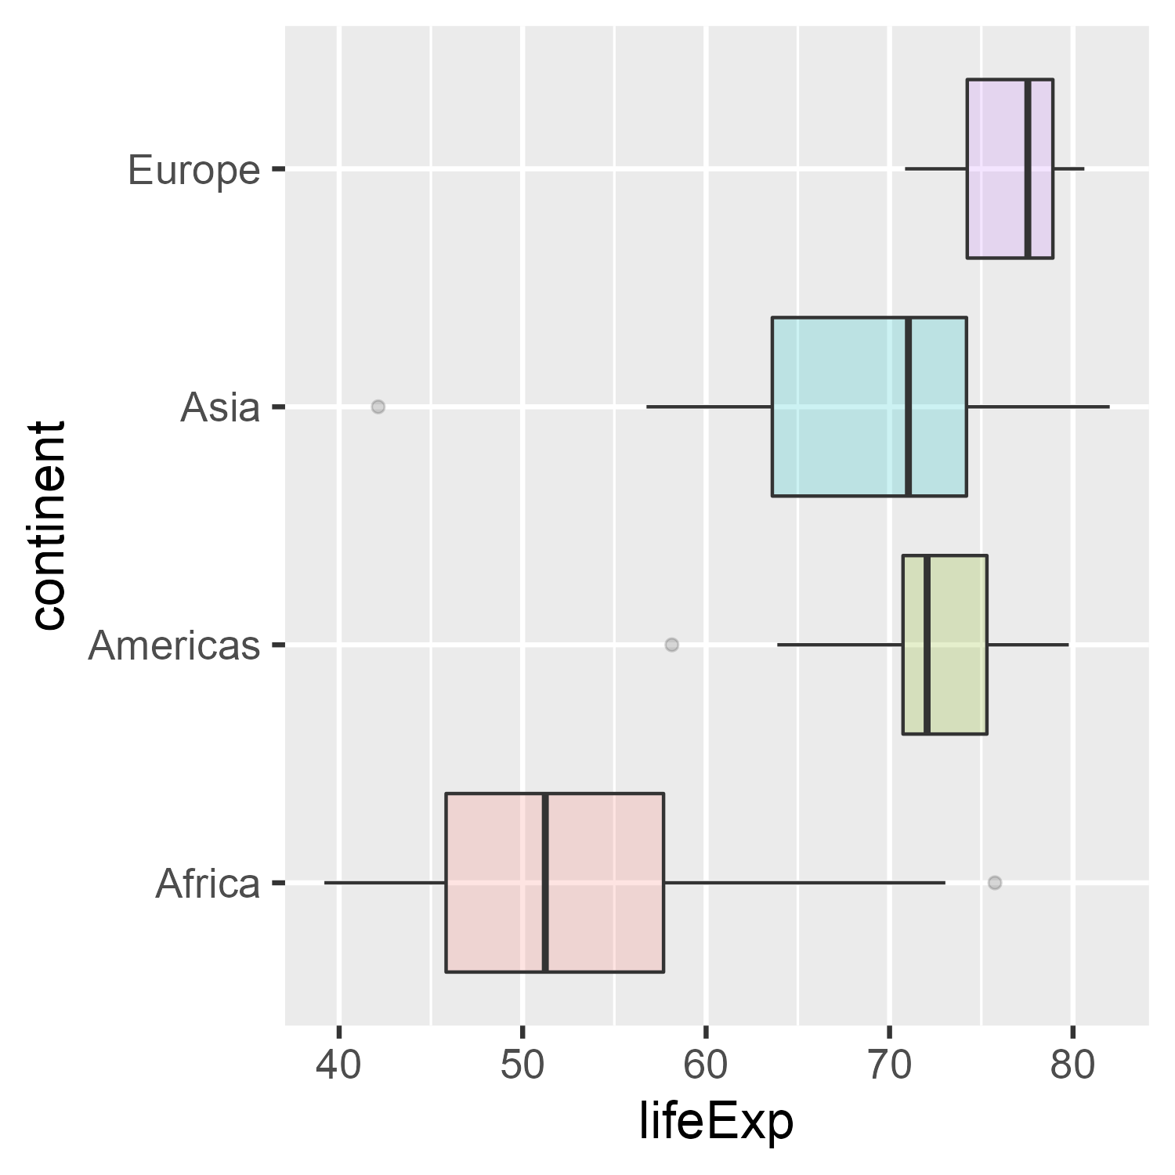
Boxplots
Boxplots give a more schematic summary of a dataset–
median, quartiles, whiskers & outliers
ggplot(gap_2002c,
aes(x=lifeExp,
y=continent,
fill=continent)) +
geom_boxplot(alpha = 0.2) +
theme(legend.position = "none")

Slide 26
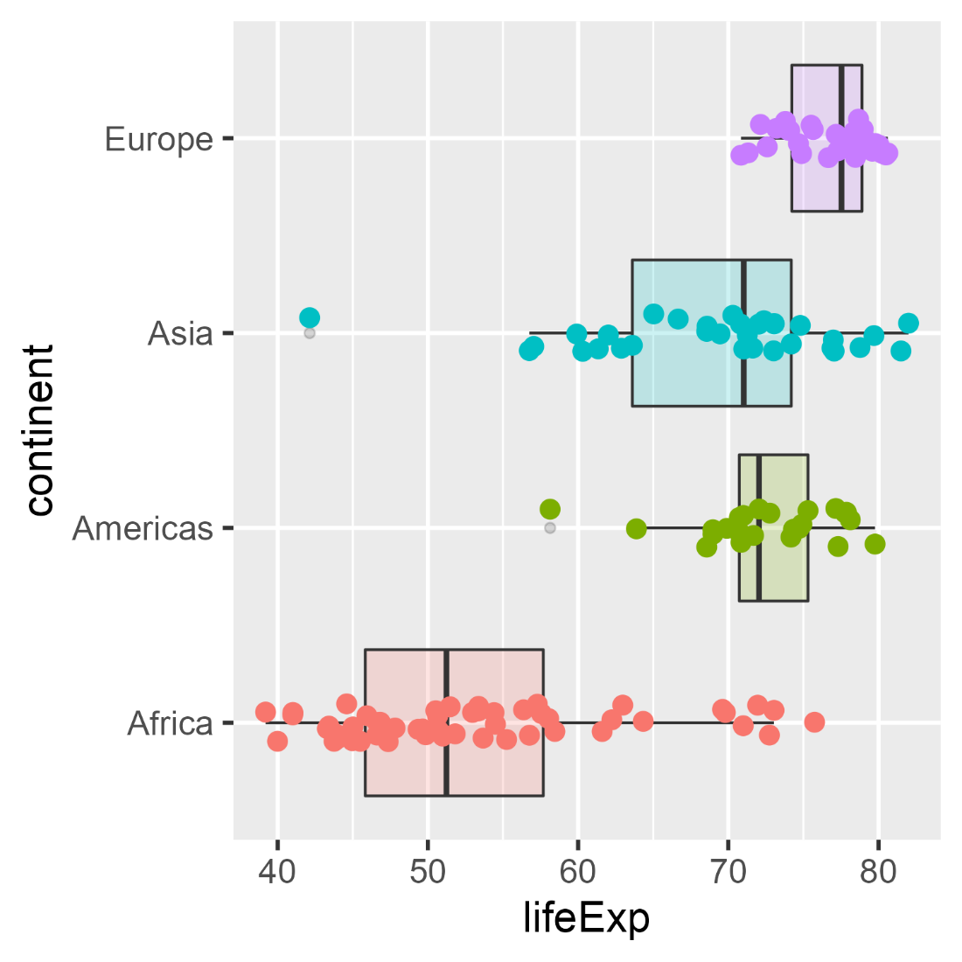
Boxplots
But perhaps too schematic– it sometimes helps to see the data as jittered points
ggplot(gap_2002c,
aes(x=lifeExp,
y=continent,
fill=continent)) +
geom_boxplot(alpha = 0.2) +
geom_point(aes(color = continent),
position =
position_jitter(height=0.1)) +
theme(legend.position = "none")

Slide 27
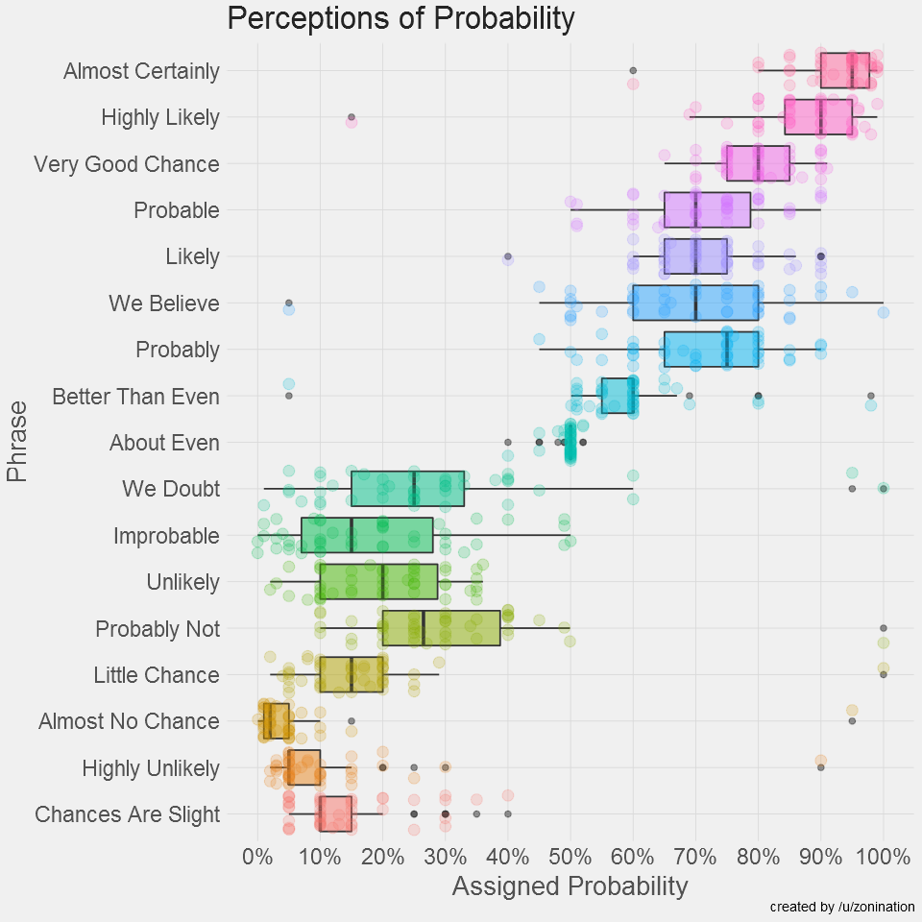
How people view “probability”
What makes this graph successful?
Note the wide range of variability (uncertainty) in the estimates:
“about even” vs. “we believe”
Outliers: individuals who misunderstood instructions?

Slide 28
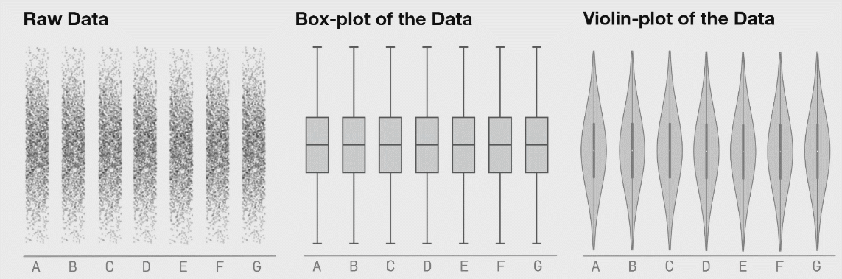
Problems with boxplots revealed
Boxplots are fine for unimodal distributions – well summarized by Q1, Median, Q3
They are insensitive to multi-modal data

Slide 29
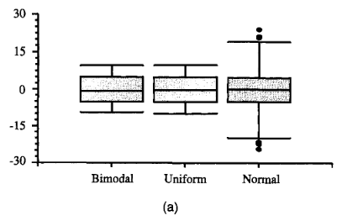
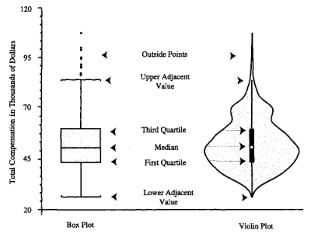
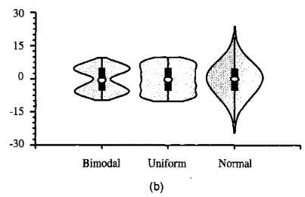
Violin plots
Boxplots are great for ~ normal data
Shows center, spread, outliers
Violin plots add a (reflected) density curve to show the shape of the distribution
Hintze & Nelson (1998), American Statistician, 52:2, 181-184

Slide 30
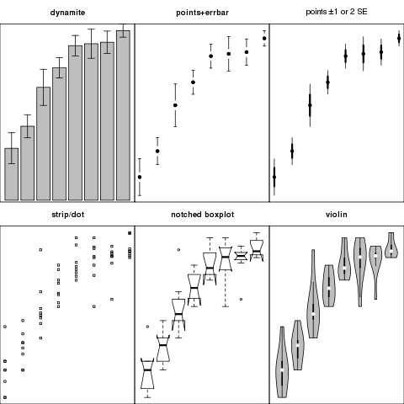
Comparing groups: Summary + Uncertainty
Six different graphs for comparing groups in a one-way design
which group means differ?
equal variability?
distribution shape?
what do error bars mean?
unusual observations?
Never use dynamite plots
Always explain what error bars mean
Consider tradeoff between summarization & exposure

Slide 31
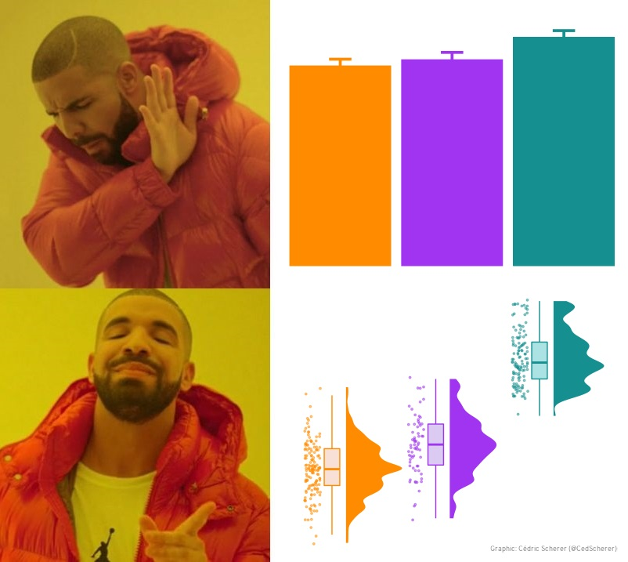
Barplot memes: Don’t dynamite me!
rage
joy

Slide 32
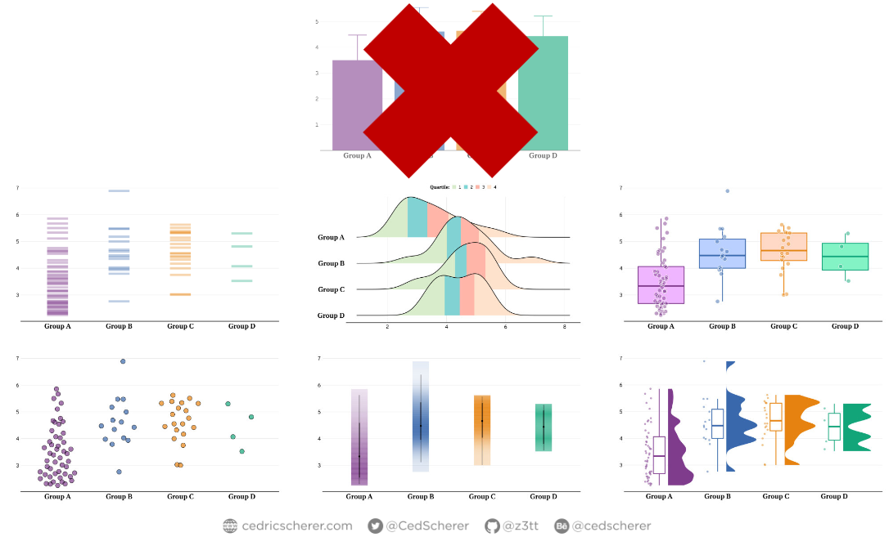
Alternatives to dynamite plots

Slide 33
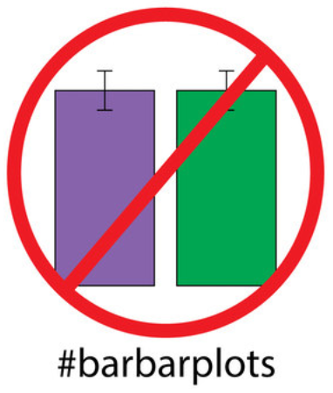
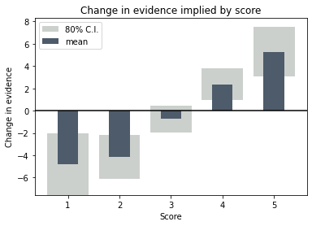
De-fusing the barplot
If you insist on bars, use a better visual representation of uncertainty or CI
“Friends don’t let friends make barplots” (video)
https://barbarplots.github.io/

Slide 34
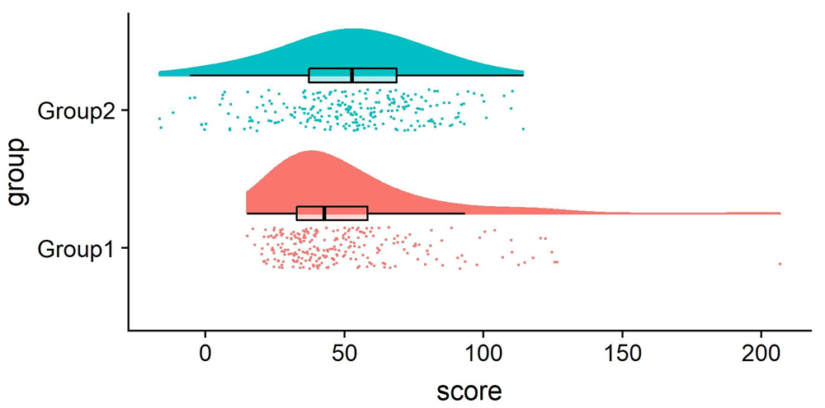
Raincloud plots
Raincloud plots combine density curve & boxplot, but also show the observations as jittered points
Allen M, Poggiali D, Whitaker K et al. Raincloud plots: a multi-platform tool for robust data visualization [version 2]. Wellcome Open Res 2021, 4:63 (doi: 10.12688/wellcomeopenres.15191.2)

Slide 35
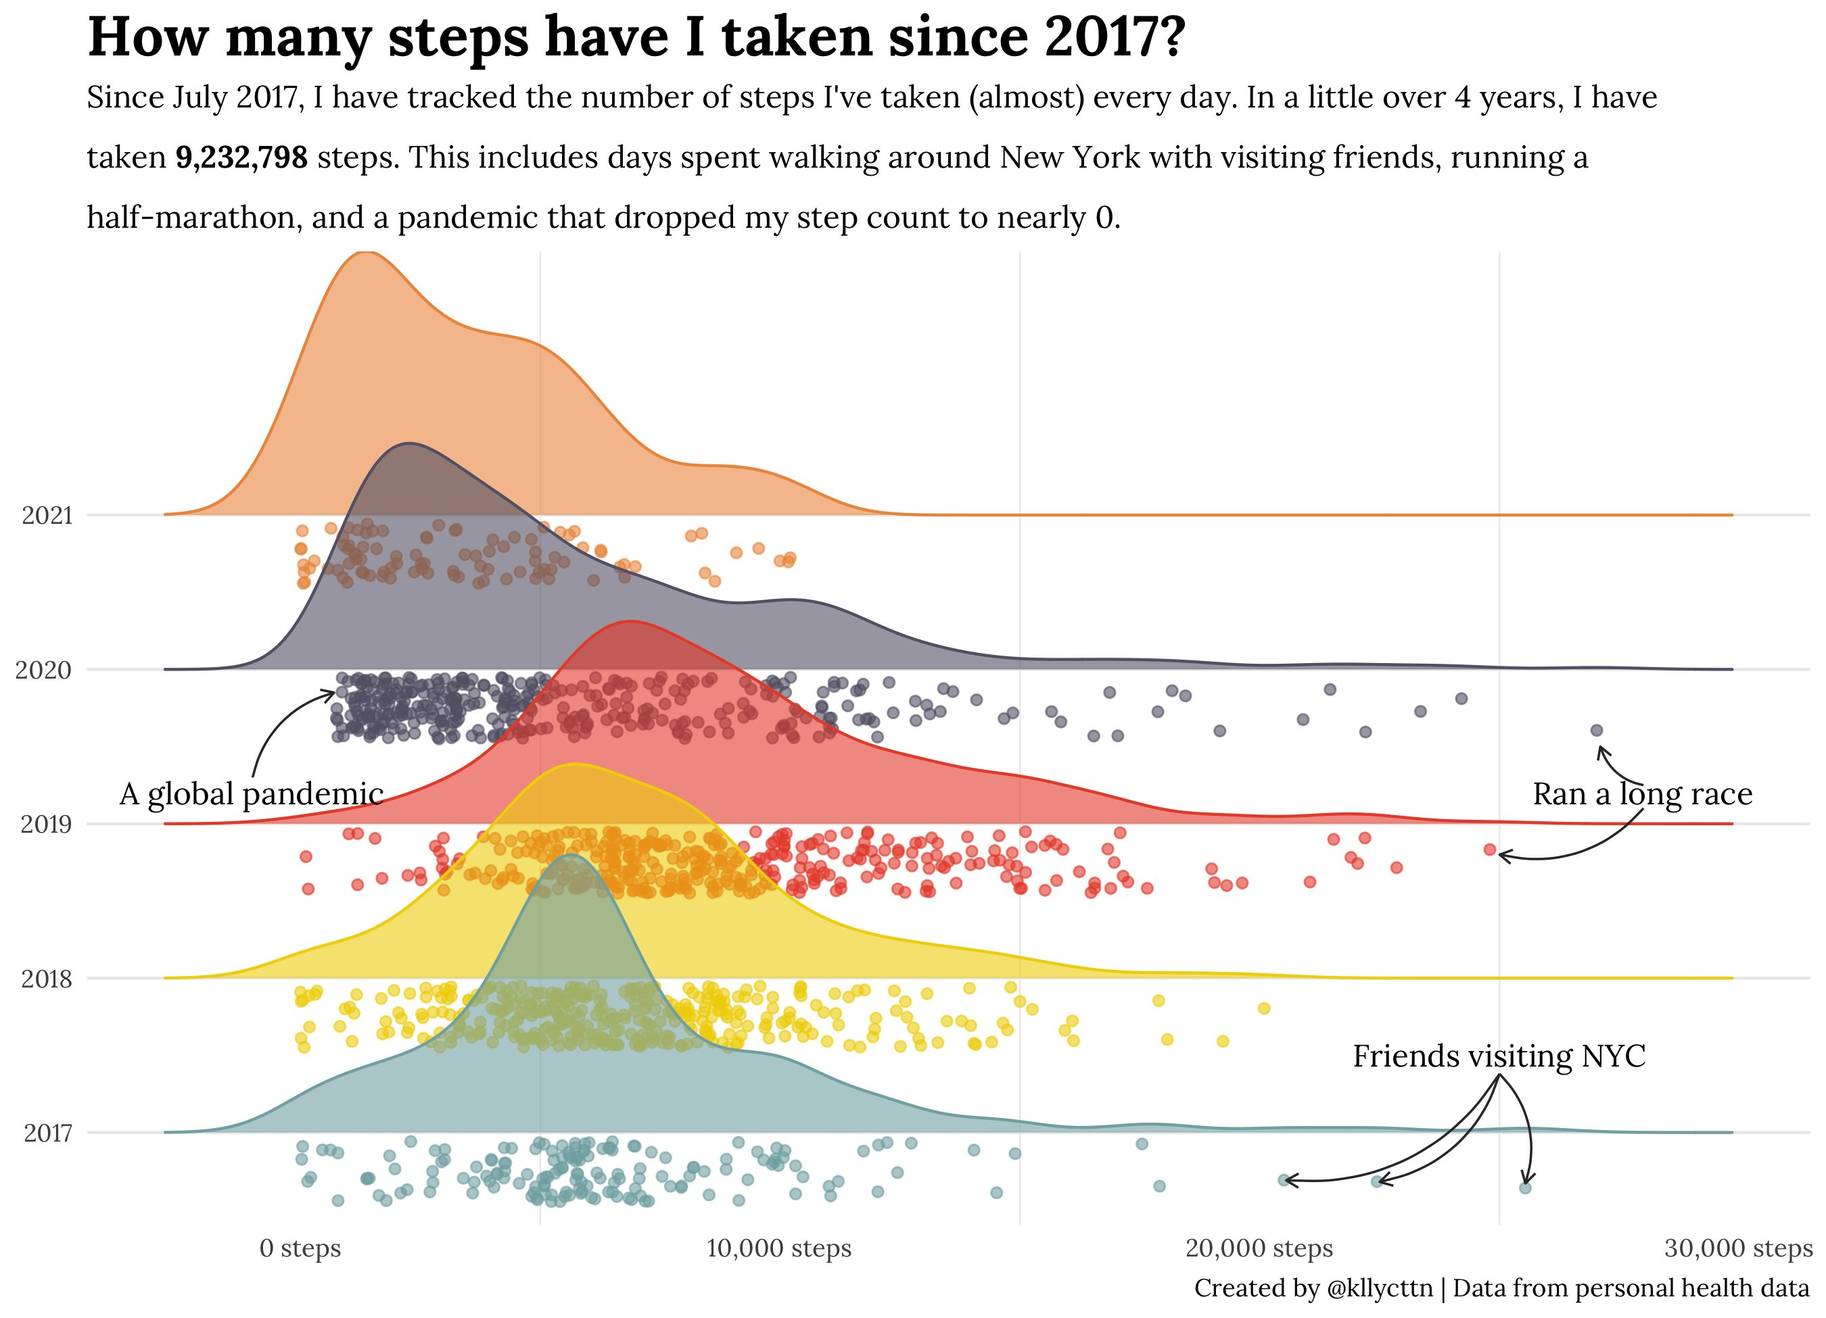
Changes in shape add to the story of changes in center
Transparency allows overlap

Slide 36
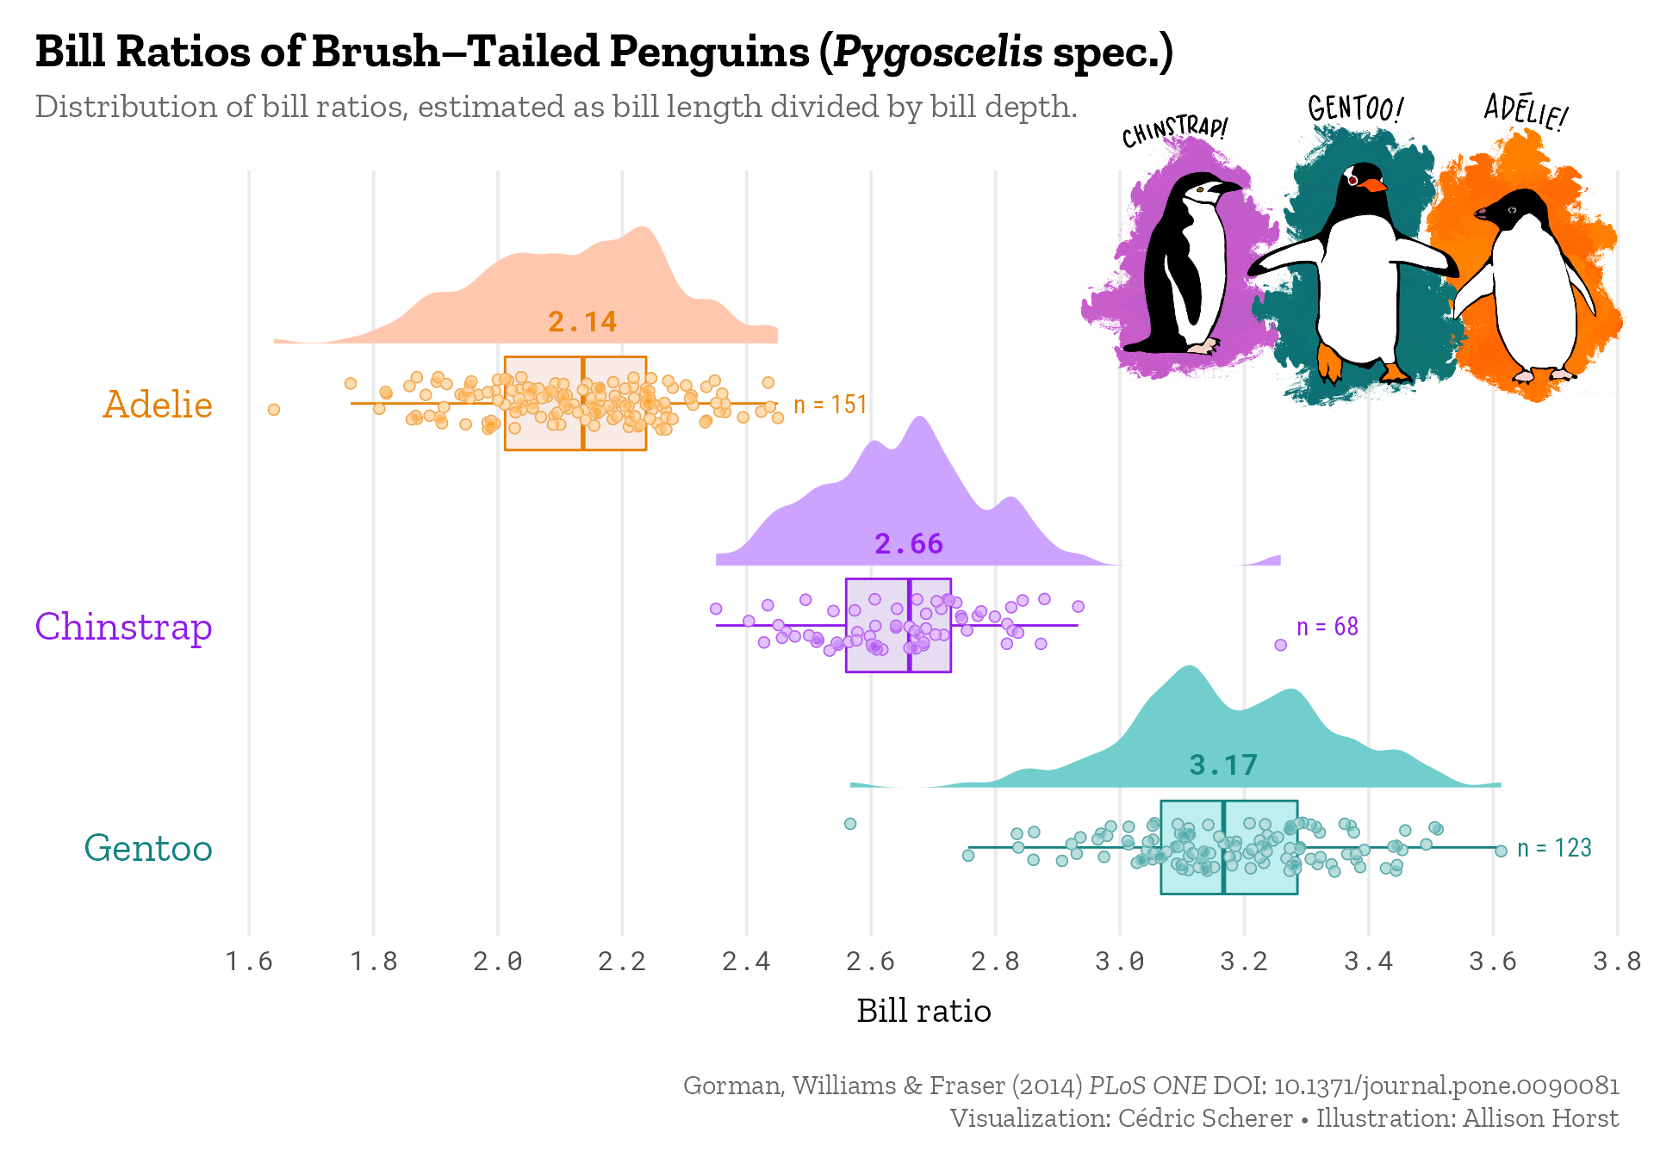
Graphical excellence!

Slide 37

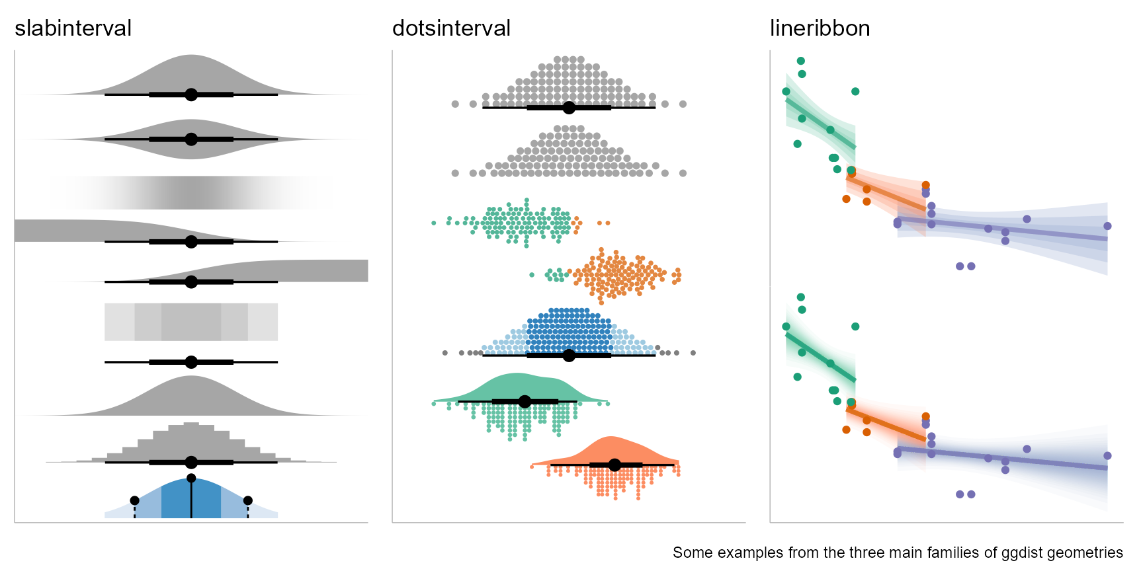
{ggdist} package
The {ggdist} package provides three families of geoms for visualizing uncertainty
Point estimates + intervals
Dots + intervals
Fitted lines + uncertainty bands

Slide 38
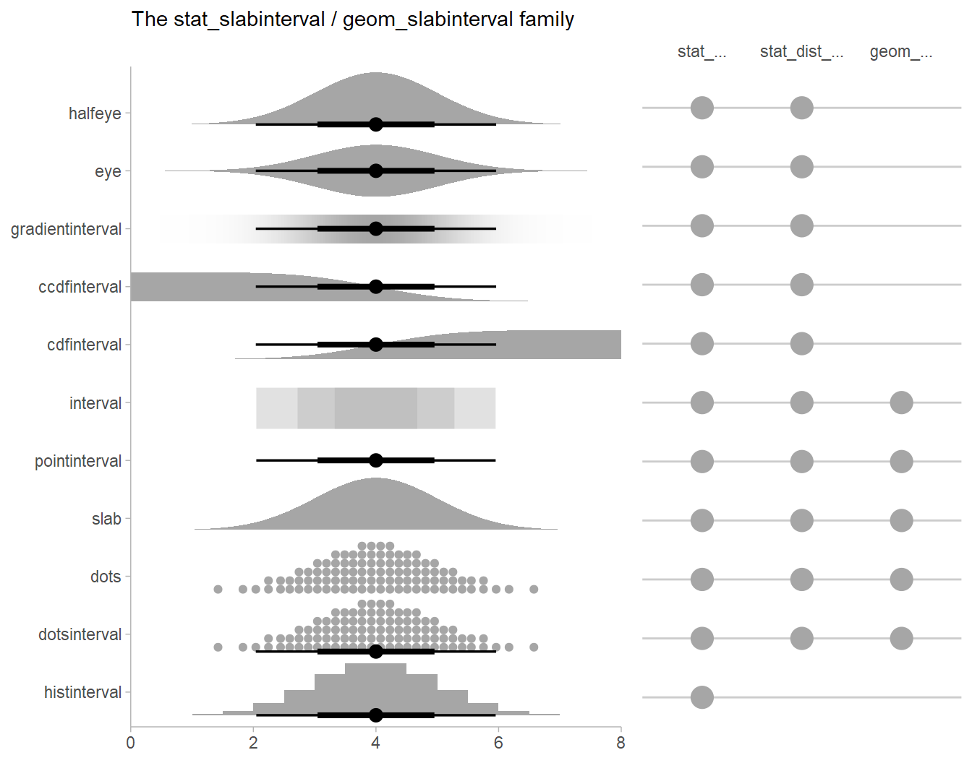
{ggdist} package
The {ggdist} package provides a wide variety of ggplot stats to display distributions & intervals

Slide 39



Design of {ggdist} makes it easy to combine two or more graphical representations –
data + distribution + interval
gradientinterval
halfeye, varying fill
dots

Slide 40

One-way ANOVA example
set.seed(5)
n <- 10; ngrps <- 5
ABC <- tibble(
grp = rep(c("A","B","C","D","E"), n),
response = rnorm(n * ngrps, c(0,1,2,1,-1), 0.5)
)
ABC.mod = lm(response ~ grp, data = ABC)
broom::tidy(ABC.mod)
Frequentist theory
# A tibble: 5 × 5
term estimate std.error statistic p.value
<chr> <dbl> <dbl> <dbl> <dbl>
1 (Intercept) 0.182 0.173 1.05 0.300
2 grpB 0.833 0.245 3.40 0.00143
3 grpC 1.69 0.245 6.91 0.0000000138
4 grpD 0.846 0.245 3.45 0.00122
5 grpE -1.12 0.245 -4.56 0.0000394
ν: df.residual(mod)
β_{i} : estimate
σ(β_{i} ): std.error

Slide 41

ABC.mod |>
tidy() |>
ggplot(aes(y = term)) +
stat_halfeye(
aes(xdist = dist_student_t(df = df.residual(ABC.mod),
mu = estimate, sigma = std.error)),
alpha = 0.5, interval_size_range = c(1, 3), color = "red") +
xlab("Response")

Slide 42


What works?
Holder & Padilla (2024): Compare different graph forms for visualizing health risk disparities between racial and other social groups
bar chart
geo-emph: jittered points, state labels, text
Holder & Padilla, Affect, Attribution, and Geographic Variability, https://bit.ly/3R8Gf9m

Slide 43

People who die most often do so because of…
How likely are you to develop disease?
I would consider changing my lifestyle to reduce risk
The govt should cover medical expenses for screening

Slide 44

Error bars
Standard deviation vs. standard error
What is a “confidence interval”
Frequentist vs. Bayesian

Slide 45






Key ideas of σtatistical σampling
μ
Frequentist theory
$$x \sim N(μ, σ)$$
σ
$$\overline{x}$$
$$s=\hat{σ}$$
$$\overline{x} \sim N(μ, σ/{√n})$$
$$s/{√n}$$
μ
From: Claus Wilke (2021), Fundamentals of Data Visualization, https://clauswilke.com/dataviz/ , Ch 16

Slide 46


Frequentist interpretation of a confidence interval
If we take our CI as:
α % will not include the true mean µ
From: https://wilkelab.org/SDS375/slides/visualizing-uncertainty.html

Slide 47

What’s a “confidence interval”?
https://bsky.app/profile/steveharoz.com/post/3ko5xd7waa42m

Slide 48

Visualizing distributions: Error bars
There are many ways to show variability in a single sample
Expert ratings of 125 chocolate bars manufactured in Canada
From: Claus Wilke (2021), Fundamentals of Data Visualization, https://clauswilke.com/dataviz/ , Ch 16

Slide 49


Comparing distributions: Sample size
means and standard deviations are similar for Canada & Switzerland
confidence interval widths ~ 1/$\sqrt{n}$
can show different sized confidence bands together
Jittered dots show the data: sample size & are there any outliers?
+/- sd
From: Claus Wilke (2021), Fundamentals of Data Visualization, https://clauswilke.com/dataviz/ , Ch 16

Slide 50

Comparing distributions: Contrasts
For comparison of one group to all others, plot the difference directly
Easy to see which differences exclude 0, at what confidence level
✓
✓✓✓
✗
✗
✗
From: Claus Wilke (2021), Fundamentals of Data Visualization, https://clauswilke.com/dataviz/ , Ch 16

Slide 51

Intervals: Direct vs. Differences
The standard error for the difference between two means is always larger than the standard error of either mean
When separate intervals are shown, the visual inference is that groups differ significantly if intervals do not overlap.

Slide 52


Pairwise comparisons chart
ggpubr::geom_pwc() adds lines to show p-values for pairwise comparisons
# Box plots with p-values
bxp <- ggboxplot(df, x = "supp", y = "len",
fill = "dose")
bxp + geom_pwc(
aes(group = dose), tip.length = 0,
method = "t_test", label = "p.adj.format")
# Adjust all p-values together after
ggadjust_pvalue(
bxp, p.adjust.method = "bonferroni",
label = "{p.adj.format}{p.adj.signif}",
hide.ns = TRUE)
Docs: https://rpkgs.datanovia.com/ggpubr/

Slide 53



What kind of intervals?
Frequentist
Bayesian
Confidence interval
Scope: repeated (hypothetical) samples
Center: parameter estimate
μ → $\overline{x}; β $ $\hat{β}$
Width: ~ std. error= $\hat{σ}$/$√n$
Interpretation: true parameter w/in this interval 1-α % (in repeated samples)
Credibility interval
Scope: repeated draws from the posterior distribution
Center: median of posterior distribution
Width: MAD sd of posterior
Interpretation: Given prior, expect parameter w/in this interval 1-α % of draws

Slide 54









Posterior = Prior × Likelihood
We have: Data, some model, some parameter(s) of interest, θ
Can calculate likelihood,
Want: posterior:
Previous research: some prior,
Bayes theorem:
$$p(Data|θ)$$
$$p(θ|Data)$$
$$p(θ)$$
likelihood
$$p(Data|θ)$$
posterior
$$p(θ|Data)$$
$$p(θ)$$
prior
credibility interval
$$θ$$
(mean, slope, …)

Slide 55

Bayesian intervals
Distribution of repeated draws from posterior distribution
From: Claus Wilke (2021), Fundamentals of Data Visualization, https://clauswilke.com/dataviz/ , Ch 16

Slide 56

tidybayes: Bayesian analysis + tidy data + geoms
The {tidybayes} package makes it easier to combine Bayesian analysis with insightful ggplot visualization
Bayesian packages: JAGS, Stan (rstanarm), brms
Inputs: data, model specifications aren’t tidy
Need to translate data into forms these packages expect
Outputs: Posterior draws, distributions aren’t tidy
Need to translate these into form suitable for summaries & plotting
→ Extract tidy fits and predictions from models
→ Summarize posterior distributions
→ Visualize priors and posteriors
Docs: http://mjskay.github.io/tidybayes/

Slide 57
The Bayesian process
data
Bayesian fit function:
stanglm()
brm(), …
draws from posterior
model
response = (1|group)
prior = c(
prior (intercept),
prior(sd)
prior(sigma))
summaries & point intervals (median, quantile intervals)
predictions

Slide 58


tidybayes plots
Everything we can do for data with {ggdist} we can do for Bayesian models with {tidybayes}
densities and intervals for model parameters
data, posterior predictions, and posterior distributions of means

Slide 59

Uncertainty in fits & curves
QQplots
Model fit plots

Slide 60
QQ plots
How close is my data to a {Normal | exponential | χ2} distribution?
There are lots of statistical tests, but these don’t tell why or where a distribution is rejected.
These tests are also overly sensitive to small departures
Plot observed Quantiles vs. theoretical Quantiles
If observed ~ theoretical with slope = 1, OK
Confidence bands help to identify deviation from model & outliers
Use cases:
Is a single variable reasonably normally distributed?
Are the residuals from my linear model Normal?
Outliers in multivariate data? D² ~ χ2 → chisq QQ plot

Slide 61

Prestige data: income
Income is clearly positively skewed.
(But normality is not required for predictors.)
This shows up as a U-shaped pattern
The 95 % confidence band shows greatest departure in the upper tail

Slide 62


Prestige data: prestige
Occupational prestige doesn’t look too normal, but not as bad as this looks
The 95% confidence band includes all the observations

Slide 63

Prestige data: residuals
Normality of residuals is more important for linear models
Some small evidence of + skew
Confidence bands help to identify potential outliers – badly fitted pts
qqPlot(lm(prestige ~ income + education + type, data=Duncan))

Slide 64

Curves + Uncertainty
Cederic Scherer used this graphic to argue about the decline of animal & freshwater populations.
Details aside, the confidence band gives visual evidence that the decline is systematic.
Q: What are the elements that contribute to graphical excellence here?
From: https://twitter.com/CedScherer/status/1380211291466399744

Slide 65


Curves + Uncertainty: Scales matter!
Arguably, percent reduction in animal population should be viewed on a log scale.
Transformed uncertainty intervals are here the logs of the Upper/Lower levels
Model: log(Pop) ~ (year – 1970)

Slide 66

Fitted curves
Data on gas mileage of Motor Trend 1974 cars
Sources of uncertainty:
Observations: measurement error in MPG and/or HP?
Model form: Linear? Quadratic? Interaction with cylinders
Model fit uncertainty: normal theory CIs? Bootstrap? Bayesian?

Slide 67
Measurement uncertainty
Sometimes, we can quantify the uncertainty (“error”) in values of x and or y.
e.g., each point is the average of n>1 cars.
Fitted models allow for errors in y:
y = f(x) + error
and find estimates to minimize error
Most fitted models assume x is measured w/o error.
Big problem if error ~ f(x, other xs)

Slide 68


Model forms: nonlinear fits
When a relation is clearly non-linear, we can fit alternative models.
The CI bands tell us where the data is too thin to rely on the predicted value.
p1 + geom_smooth(method = lm, formula = y~poly(x,2), …)
p1 + geom_smooth(method = loess, formula = y~x, …)

Slide 69
Fitted curves: smoothers
In each case, the confidence band gives visual evidence for uncertainty of the predicted values.
But, uncertainty may be expressed differently.
a formula for std. error based on normal/large sample theory
envelope of (normal) simulations
Bayesian predictive distribution

Slide 70

Interaction models
The non-linear relation between hp & mpg can (arguably) be better explained by a model that allows different slopes for 4, 6, 8 cylinders.
The graph shows normal theory Cis at 95%, 90%, and 80% for each cylinder level
Transparency of CIs → visual representation of levels of confidence

Slide 71

Hypothetical Outcome Plots
Rather than showing a complete distribution or point estimate and error bars, Hypothetical Outcome Plots (HOPs) visualize a set of draws from a distribution
each draw is shown as a new plot in either a small multiples or animated form.

Slide 72

Simulations to convey uncertainty
Simulating fits from the data (e.g., bootstrap, Bayesian estimation) shows the variability. Doesn’t rely on classical, normal theory.

Slide 73

Animation to understand uncertainty
All assessments of uncertainty rely on a comparison: data vs. what could have been
Sampling distributions, simulations, Bayesian posterior distributions, …
Sometimes useful to appreciate the variability with animated graphics

Slide 74

Replication uncertainty: Meta analysis
In meta analysis, we have multiple studies reporting the same effect.
How to visualize/compare effect sizes?
How to calculate a pooled, overall effect?
How to assess heterogeneity of effects?
Forrest plot
From: Harrer, Doing Meta Analysis in R

Slide 75

Forrest plots
Effect size: std. measure of size of effect (g)
Study weight: ~ 1/ SE2
Pooled effect: weighted average of effect sizes
meta::forrest()

Slide 76


Reporting the meta study process
traditional process diagram
animated version

Slide 77

Publication bias: Funnel plots
Publication bias: NS studies less likely to be published → effect overestimated
Funnel plot: Plot std. error vs. observed effect size
Should be symmetric when no publication bias
meta::funnel(studies)
no effect
confidence interval
Lucky studies?
HARKing?

Slide 78

Contour-enhanced funnel plots
Funnel plots can be enhanced by showing contours of p-values
meta::funnel(studies, contour = c(0.9, 0.95, 0.99))
From: Harrer, Doing Meta Analysis in R

Slide 79

Orchard plots
Plot for interaction (moderator) effects between mechanism of colour production and pollutant type
Color production
Janas et al (2024) Avian colouration in a polluted world: a meta-analysis/ https://doi.org/10.1111/brv.13067

Slide 80

Geographic Uncertainty
Historical maps
Hurricane maps
Coding maps for uncertainty
Empirical studies

Slide 81

Uncertainty in historical maps
Abraham Ortelius, Theatrum Orbis Terrarum, 1570
Monsters and other imagined creatures used to mark or mask unexplored areas
Here Be Dragons!

Slide 82

Uncertainty in historical maps
Abraham Ortelius, Geographia Sacra, 1603
Source of the Nile?
Don’t know!
Hide in a cartouche
Location of Ophir (mentioned in Bible)
text describes 4 possible locations
Van Duzer, Some Methods for Indicating Cartographic Uncertainty, Fifteenth through Eighteenth Centuries,
https://dx.doi.org/10.55283/jhk.13795

Slide 83

Uncertainty in historical maps
John Smith’s map, Virgina, 1612
Uses ● markers to distinguish places he has visited, vs. those he just heard about
Van Duzer, Some Methods for Indicating Cartographic Uncertainty, Fifteenth through Eighteenth Centuries,
https://dx.doi.org/10.55283/jhk.13795

Slide 84

Geographic uncertainty
Predicting the path of hurricanes:
Given what we can measure today (location, wind speed, direction, …) where is this hurricane likely to be in 1 day, 3 days, 5 days?
Most forecasts are based on an ensemble of predictions, representing the uncertainty in initial conditions, model physics, …
Often this is represented as a “cone of uncertainty”

Slide 85

What is the Cone of Uncertainty?
As seen on TV:
The center is meant to track the average prediction, either over models or history
The cone size generally represents some “2/3 confidence interval”
Does this mean I am safe if I lived in Tallahassee FL in 2005? 2020?
From: https://www.youtube.com/watch?v=nE6XaHtpm04

Slide 86

The Incredible Shrinking Cone
Changes in presumed accuracy are often shown as below
The cone represents the probable track of the center of a tropical cyclone, formed by enclosing the area swept out by a set of circles along the forecast track (at 12, 24, 36 hours, etc).
The size of each circle is set so that two-thirds of historical official forecast errors over a 5-year sample fall within the circle.

Slide 87

Sharpiegate
In Sept. 2019, Donald Trump went live with “extrapolated” predictions of the path of Hurricane Dorian.
He had earlier predicted it would hit Alabama & Georgia.
Let it be said, let it be written (with a sharpie)
sharpie extrapolation
model extrapolation
model forecast
From: https://www.theguardian.com/us-news/2019/sep/05/trump-hurricane-dorian-alabama-map-sharpiegate

Slide 88

Coding maps for uncertainty
In choropleth maps we can show uncertainty with another visual attribute
Greater stipling → less certainty
Q: Are these separable dimensions?
Can you focus on happiness or certainty?
From: https://www.e-education.psu.edu/geog486/node/693

Slide 89

Studies
Cheong et al. (2016)
Participants presented with a house location (“X”)
Asked if they would stay or leave based on one of the wildfire hazard communication techniques shown here
Results:
Display type mattered little when given 30 sec. to decide
With time pressure (5 sec.):
color hue was best
Text & simple boundary worst
Cheong, etal. (2016). Evaluating the impact of visualization of wildfire hazard upon decision making under uncertainty. International Journal of Geographical Information Science, 30(7), 1377–1404.

Slide 90
Summary
Uncertainty is fundamental to data analysis & models
Showing variation in distributions a basic problem
histograms, density plots, boxplots
Better: violin, raincloud, …
{ggdist} offers many alternatives
Error bars: many flavors; can show multiple intervals
Bayesian methods, bootstrap, simulation
Different methods, but similar ways to show uncertainty
Geographic data: need to be careful about interpretations

